Slide 1

Docker Foundation
An in depth introduction to Docker and Containers

Slide 2
Docker in Practice
Volumes
Security
Networking
Swarm

Slide 3
1: Volumes

Slide 4
Objectives
Define the term “data volume”
List three ways to create volumes with Docker
Gain experience with the docker volume command
Learn how to use --volumes-from
Understand the Docker volume architecture

Slide 5
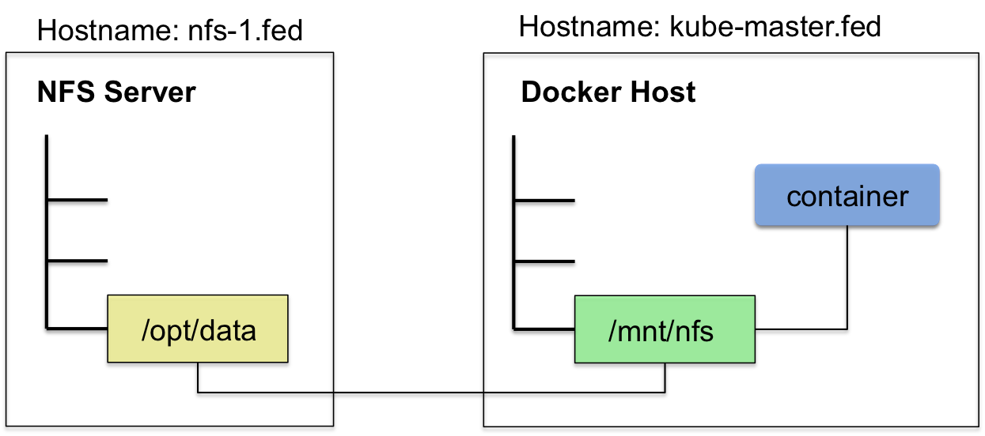
What is a docker volume
Volumes:
Hold data
Can be shared/reused across containers
Store data in the host file system not the container layer
Support 3rd party volume plugins for advanced storage facilities
A volume mounts a host directory into a container directory
Any part of the host file system can be mapped into a container as a volume
Any part of a container’s file system can be configured as a volume
Volumes decouple the life of the data from the life of the container(s)
You can docker rm some_container without affecting the volumes it uses
Running containers can be ephemeral and data can be persistent
Docker never automatically deletes volumes when you remove a container, nor will it "garbage collect" volumes that are no longer referenced by a container
Volumes bypass the layered file system
This makes volumes as fast as the host based filesystem
Changes to a volume will not be included when you update an image by committing the container

Slide 6
Volumes
A volume can be created in three ways:
$ docker volume create … # With the docker volume cmd
$ docker run -v /host/path:/some/cont/dir ... # With the docker run cmd
VOLUME /some/dir # Within a Dockerfile

Slide 7
Mounting Host Paths
A host path volume can be automatically mounted within a docker container using the docker run -v switch
Volumes default to read/write
To mount a volume read only use the :ro suffix
$ sudo docker run -d -P --name web -v /src/wapp:/opt/wapp:ro cisco/wapp python app.py
The -v flag can also be used to mount a single file
$ sudo docker run --rm -it -v ~/.bash_history:/.bash_history ubuntu /bin/bash
docker@ubuntu:~$ mkdir data
docker@ubuntu:~$ cd data
docker@ubuntu:~/data$ vim README.md
docker@ubuntu:~/data$ cd ..
docker@ubuntu:~$ docker run –i -t -v ~/data:/webdata --name="web01" ubuntu:14.04 /bin/bash
root@2e5cf445a1b5:/# cat /webdata/README.md
shared Docker data
root@2e5cf445a1b5:/# exit
exit
docker@ubuntu:~$

Slide 8
Volume Architecture
Volumes map container paths to host paths
When no host path is supplied Docker creates one (this feature is deprecated)
Still works in 1.12.x
MountPoints are found in metadata
Can mount read only (:ro flag)
-v /src:/dest:ro
Volumes have a UUID
user@ubuntu:~$ docker run -it -v /some/dir ubuntu
root@0f28f53ab19b:/# echo "hello volumes" > /some/dir/test.md
root@0f28f53ab19b:/# ls -l /some/dir
total 4
-rw-r--r-- 1 root root 14 Nov 4 22:34 test.md
user@ubuntu:~$ docker run -it --volumes-from=0f28f53ab19b ubuntu
root@731342f95ab8:/# cat /some/dir/test.md
hello volumes
$ docker inspect -f '{{.Mounts}}' 0f28f53ab19b
[{52b4bd60ebd13131ba36411619aec608929d54bc5b96bd62b69821fabc2b9d52 /var/lib/docker/volumes/52b4bd60ebd13131ba36411619aec608929d54bc5b96bd62b69821fabc2b9d52/_data /some/dir local true}]
$ sudo ls -l /var/lib/docker/volumes/52b4bd60ebd13131ba36411619aec608929d54bc5b96bd62b69821fabc2b9d52/_data
-rw-r--r-- 1 root root 14 Nov 4 14:34 test.md
user@ubuntu:~$ sudo grep -r 52b4bd60ebd13131ba36411619aec608929d54bc5b96bd62b69821fabc2b9d52 /var/lib/docker
/var/lib/docker/containers/731342f95ab86c33db539ce455a5a01149e4db5991e688077c7e8c6d16ac725e/config.json: {...,
"MountPoints": {
"/some/dir": {
"Name":"52b4bd60ebd13131ba36411619aec608929d54bc5b96bd62b69821fabc2b9d52",
"Destination":"/some/dir",
"Driver":"local",
"RW":true,
"Source":"",
"Relabel":""
}
},
"Volumes": {
"/some/dir":"/var/lib/docker/volumes/52b4bd60ebd13131ba36411619aec608929d54bc5b96bd62b69821fabc2b9d52/_data"
},
"VolumesRW":{
"/some/dir":true
}
}
/var/lib/docker/containers/0f28f53ab19b81741f8c854a09a983454025922a395d786d67c9769635afa311/config.json:{...

Slide 9
docker volume
user@ubuntu:~$ docker volume ls
DRIVER VOLUME NAME
user@ubuntu:~$ docker run -v /var/test centos:6
user@ubuntu:~$ docker volume ls
DRIVER VOLUME NAME
local b594c8ef1dd7686d4071e6dadd613635ea942bc06a17ab31057cc0bc8879d853
user@ubuntu:~$ docker volume inspect b594c8ef1dd7686d4071e6dadd613635ea942bc06a17ab31057cc0bc8879d853
[
{
"Name": "b594c8ef1dd7686d4071e6dadd613635ea942bc06a17ab31057cc0bc8879d853",
"Driver": "local",
"Mountpoint": "/var/lib/docker/volumes/b594c8ef1dd7686d4071e6dadd613635ea942bc06a17ab31057cc0bc8879d853/_data"
}
]
user@ubuntu:~$ docker volume rm b594c8ef1dd7686d4071e6dadd613635ea942bc06a17ab31057cc0bc8879d853
Error response from daemon: Conflict: volume is in use
user@ubuntu:~$ docker ps -a
CONTAINER ID IMAGE COMMAND CREATED STATUS
e27f2f7a1096 centos:6 "/bin/bash" 3 minutes ago Exited (0) 3 minutes ago
user@ubuntu:~$ docker rm e27f2f7a1096
e27f2f7a1096
user@ubuntu:~$ docker volume rm b594c8ef1dd7686d4071e6dadd613635ea942bc06a17ab31057cc0bc8879d853
b594c8ef1dd7686d4071e6dadd613635ea942bc06a17ab31057cc0bc8879d853
user@ubuntu:~$ docker volume ls
DRIVER VOLUME NAME
user@ubuntu:~$ docker volume create --name logdata
logdata
user@ubuntu:~$ docker run -v logdata:/var/log/data -it centos:6
[root@05c961908425 /]# echo "shared volume" > /var/log/data/output
[root@05c961908425 /]# exit
exit
user@ubuntu:~$ docker run -v logdata:/var/log/data -it ubuntu
root@6ed0aeaa4c3e:/# cat /var/log/data/output
shared volume
root@6ed0aeaa4c3e:/#
The docker volume command is new in v1.9
docker volume create
docker volume inspect
docker volume ls
docker volume rm
docker volume help

Slide 10
Volumes From
Containers can expose Docker managed host paths to other containers
This allows containers to depend directly on other containers, not the underlying volume
If you have some persistent data that you want to share between containers, or want to use from non-persistent containers, it's best to:
[Docker <= 1.8] Create a named Data Volume Container, and then mount the volumes from that container into other containers
[Docker >= 1.9] Create a named Volume, and then mount the named volume in other containers
Data volume containers do not typically run applications
$ sudo docker create -v /dbdata --name dbdata bobs/postgres
--volumes-from
Used to mount a volume from one container in another container
$ sudo docker run -d --volumes-from dbdata --name db1 bobs/postgres
$ sudo docker run -d --volumes-from dbdata --name db2 bobs/postgres
You can use multiple --volumes-from parameters to bring together multiple data volumes from multiple containers
You can also mount a volume from a container, which in turn was mounted from another container
$ sudo docker run -d --name db3 --volumes-from db1 bobs/postgres

Slide 11
Removing Volumes
If you remove containers that mount volumes the volumes will not be deleted
To delete the volume from disk, you must explicitly call docker rm -v against the last container with a reference to the volume
Alternatively the docker volume rm command can be used to remove volumes

Slide 12
Container Volumes (pre docker 1.9)
Data Containers are a design pattern wherein data volumes are owned by data containers
Post Docker v1.9 Data Containers are no longer necessary, volumes can now be managed independently of containers using the docker volume command
Older versions of Docker still widely use (and benefit from) the data container pattern
Data containers run no process
$ docker create -v ~/data:/webdata --name="webdata“ ubuntu:14.04
$ docker run -d --volumes-from webdata --name db1 bobs/postgres
Data Containers exist to own volumes
Related containers then use “--volumes-from” to mount volumes held by the data container
A range of operational containers can perform independent tasks in this way
User facing applications
Backups
Log processing
Big data jobs
Etc.
App Container
db1
App Container
db2
Running
Not Running
Data Container
webdata
Data Volume
~/data
Separation of Concerns
Running containers are isolated from the underlying volume mount path and can come and go
Data containers manage the actual location of the data

Slide 13
Summary
Volumes are storage mounted from outside of a container bypassing the container union filesystem and with an independent lifespan
Volumes can be created with
docker volume create
docker run -v
The Dockerfile VOLUME instruction
The docker volume command allows you to create, list, remove and inspect volumes
The --volumes-from switch allows one container to mount the volumes from another

Slide 14
Lab 1
Working with Volumes

Slide 15
2: Security

Slide 16
Objectives
Explain the nature and use of Linux Capabilities with Docker
Describe the benefits and dangers of –privileged
List the container device options
Explore the Docker --security-opt systems supported
Understand user namespaces
Discuss security best practices

Slide 17
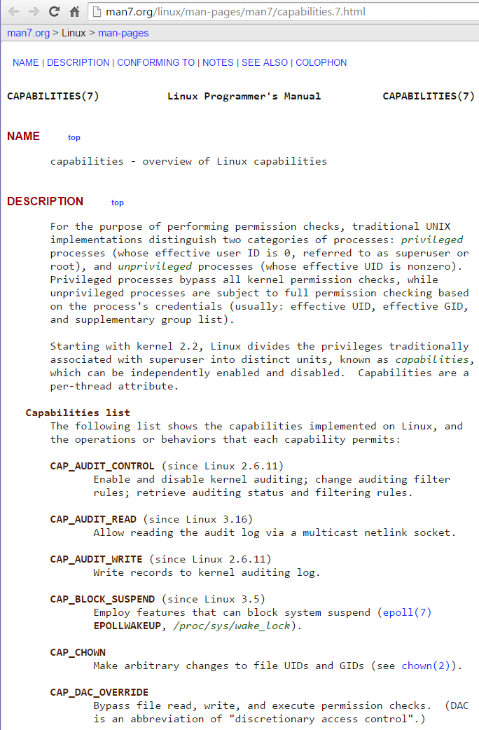
Capabilities
The docker run command offers several security related switches
--privileged
Grants all capabilities inside a container (no whitelist)
Not recommended for production (container processes run as if directly on the host)
--cap-add & --cap-drop (v1.2)
Linux Capabilities turn the binary "root/non-root" dichotomy into a fine-grained access control system
Containers can be given complete capabilities or they can follow a whitelist of allowed capabilities
--cap-add/drop give you fine grain control over Linux Capabilities granted to a particular container
Examples:
docker run --cap-add=NET_ADMIN ubuntu sh -c "ip link eth0 down"
docker run --cap-drop=CHOWN ...
docker run --cap-add=ALL --cap-drop=MKNOD ...
Linux Capabilities documentation: http://man7.org/linux/man-pages/man7/capabilities.7.html
There are currently 38 separate capabilities

Slide 18
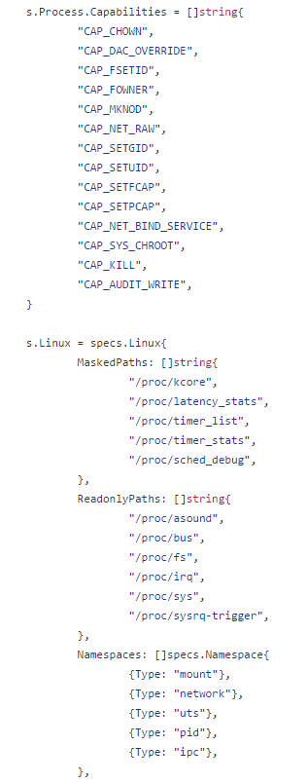
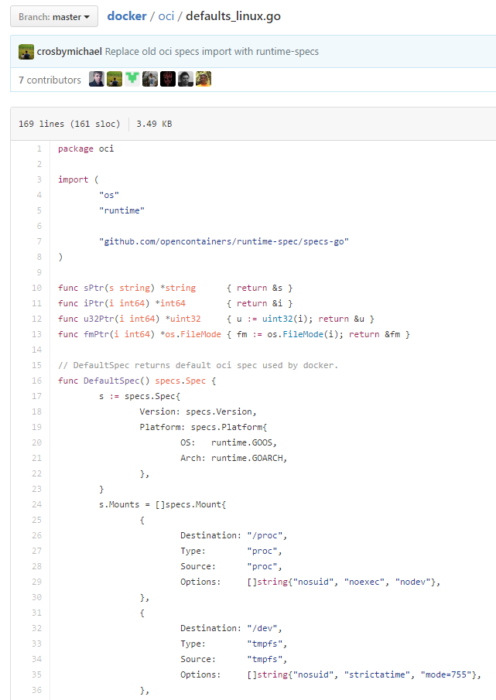
Default Capabilities
Default Capabilities
https://github.com/docker/docker/blob/master/oci/defaults_linux.go
Docker Linux Capability defaults (White List)

Slide 19
Displaying Capabilities
capsh can be used to display and change capabilities
user@ubuntu:~$ capsh --print
Current: =
…
root@ubuntu:/# capsh --print
Current: = cap_chown, cap_dac_override, cap_fowner, cap_fsetid, cap_kill, cap_setgid, cap_setuid, cap_setpcap, cap_net_bind_service, cap_net_admin, cap_net_raw, cap_sys_chroot, cap_mknod, cap_audit_write, cap_setfcap+eip
…
user@ubuntu:~$ sudo capsh --print
[sudo] password for user:
Current: = cap_chown, cap_dac_override, cap_dac_read_search, cap_fowner, cap_fsetid, cap_kill, cap_setgid, cap_setuid, cap_setpcap, cap_linux_immutable, cap_net_bind_service, cap_net_broadcast, cap_net_admin, cap_net_raw, cap_ipc_lock, cap_ipc_owner, cap_sys_module, cap_sys_rawio, cap_sys_chroot, cap_sys_ptrace, cap_sys_pacct, cap_sys_admin, cap_sys_boot, cap_sys_nice, cap_sys_resource, cap_sys_time, cap_sys_tty_config, cap_mknod,cap_lease, cap_audit_write, cap_audit_control, cap_setfcap, cap_mac_override, cap_mac_admin, cap_syslog, cap_wake_alarm, cap_block_suspend, 37+ep

Slide 20
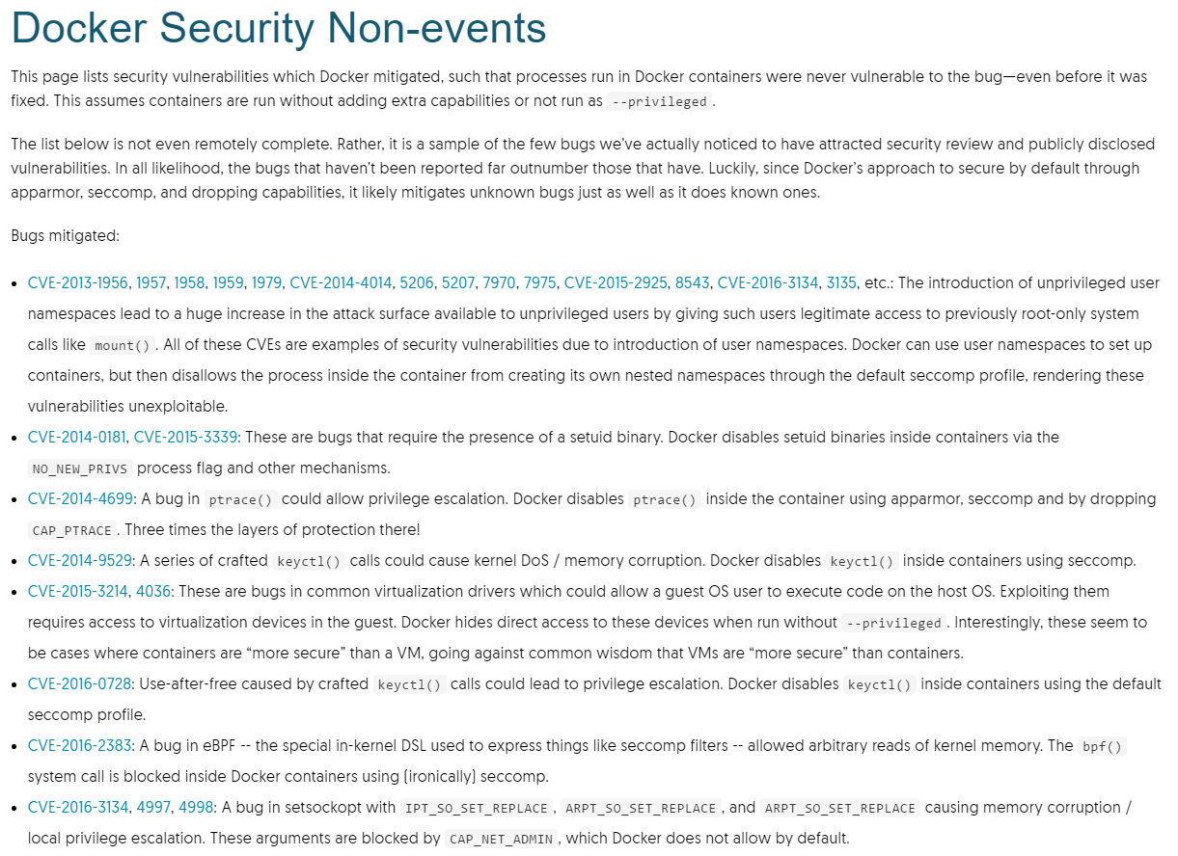
Container Value Add

Slide 21
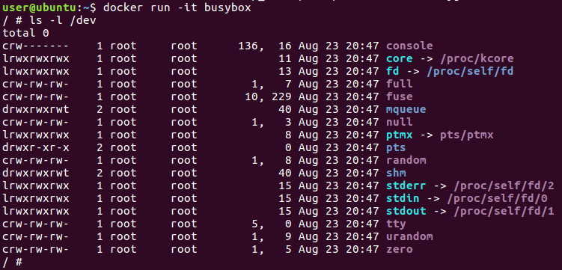
Devices
Containers have a minimal set of devices by default
Other needed devices from the host can be mapped into a container
You can use devices in privileged containers by bind mounting them ( with `-v`)
A better option may be --device (v1.2)
The --device flag lets you use a device without --privileged
Examples:
docker run --device=/dev/snd:/dev/snd ...
The console device is created by the run -t switch

Slide 22
Security Options
--security-opt (v1.3)
Sets custom SELinux labels, AppArmor profiles and SecComp files
All confine programs (not users) to a limited set of resources
SELinux
A policy (“svirt_apache”) allowing a container process to listen only on Apache ports can be applied as follows:
docker run --security-opt label:type:svirt_apache -i -t centos bash
AppArmor
The Docker binary installs a docker-default AppArmor profile in /etc/apparmor.d/docker
Moderately protective while providing wide application compatibility
Used on containers when AppArmor is enabled
A profile for the Docker Engine daemon exists but it is not currently installed with the deb packages
located in contrib/apparmor in the Docker Engine source
root@ubuntu:~# cat /etc/apparmor.d/docker
#include <tunables/global>
profile docker-default flags=(attach_disconnected,mediate_deleted) {
#include <abstractions/base>
network,
capability,
file,
umount,
deny @{PROC}/* w, # deny write for all files directly in /proc (not in a subdir)
# deny write to files not in /proc/<number>/** or /proc/sys/**
deny @{PROC}/{[^1-9],[^1-9][^0-9],[^1-9s][^0-9y][^0-9s],[^1-9][^0-9][^0-9][^0-9]*}/** w,
deny @{PROC}/sys/[^k]** w, # deny /proc/sys except /proc/sys/k* (effectively /proc/sys/kernel)
deny @{PROC}/sys/kernel/{?,??,[^s][^h][^m]**} w, # deny everything except shm* in /proc/sys/kernel/
deny @{PROC}/sysrq-trigger rwklx,
deny @{PROC}/mem rwklx,
deny @{PROC}/kmem rwklx,
deny @{PROC}/kcore rwklx,
deny mount,
deny /sys/[^f]*/** wklx,
deny /sys/f[^s]*/** wklx,
deny /sys/fs/[^c]*/** wklx,
deny /sys/fs/c[^g]*/** wklx,
deny /sys/fs/cg[^r]*/** wklx,
deny /sys/firmware/efi/efivars/** rwklx,
deny /sys/kernel/security/** rwklx,
# suppress ptrace denials when using 'docker ps' or using 'ps' inside a container
ptrace (trace,read) peer=docker-default,
}
root@ubuntu:~#

Slide 23
Docker v1.10 Security Improvements
Many security improvements were added in Docker v1.10
Seccomp
Secure computing mode (Seccomp) is a Linux kernel feature
Requires a kernel configured with CONFIG_SECCOMP
Seccomp was developed by Google to remove system calls from a process (used with Chrome plugins)
There are 600 syscalls and a bug in any one could enable privilege escalation
libseccomp was created by Red Hat’s Paul Moore to simplify the management of the syscall tree, now used in tools like qemu, system, lxc tools and Docker
Docker v1.10 --security-opt now allows admins to configure seccomp profiles per container
docker run --rm -it --security-opt seccomp:/path/to/seccomp/profile.json hello-world
Seccomp profiles require seccomp 2.2.1
Only available with
Debian 9 “Stretch” +
Ubuntu 15.10 “Wily” +
Fedora 22 +
CentOS 7 +
Oracle Linux 7 +
Seccomp backports
Ubuntu 14.04, Debian Wheezy, or Debian Jessie can download a static Docker Linux binary (not available for other distributions)

Slide 24
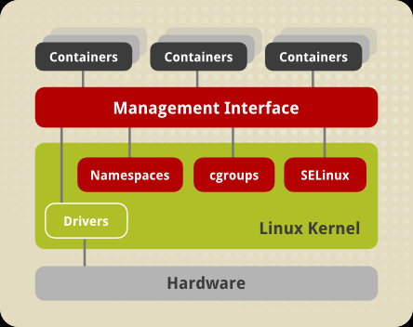
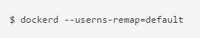
Docker v1.10 Security Improvements
User namespaces
A kernel namespace allowing separation between UIDs on the host and the container
Added to Linux kernel 2.6 in 2008, enabled in most distros after 2014
A range of container UID/GIDs (e.g. 0-1,000) map into the host user namespace as 70,000-71,000
e.g. the kernel treats UID 0 (root) inside the container as UID 70,000 outside the container (nobody)
Any UID on a file or a process that is not in the mapped range would be treated as UID=-1 and not be accessible in the container
Many kernel subsystems are not namespaced and are accessible to containers making this a key security improvement (e.g. SELinux, Kernel Modules and some paths for /sys, /proc, and /dev)
Now the best user to use inside a container is ROOT!
Options for --userns-remap
default – maps container users (including root) to a range of high number host users
uid – maps root to the specified user
uid:gid – maps root to the specified user and group
username – maps root to the specified user
username:groupname – maps root to the specified user and group

Slide 25
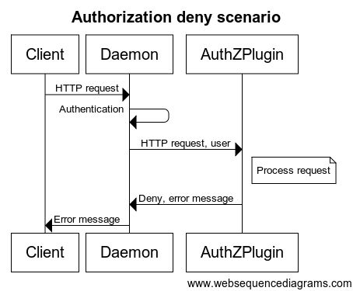
Docker v1.10 Security Improvements
Many security improvements were added in Docker v1.10
Auth
Prior to Docker v1.10, if you can talk to Docker's socket you can do anything
The new Docker daemon --authorization-plugin flag allows admins to add RBAC (role based access control) authorization features
Auth plugins act as interceptors that can allow/deny any docker API request based on rules created by admins
Plugins receive the current authentication context and the command context
You can install multiple plugins and chain them together in a defined order
All plugins must GRANT access for access to succeed
Shortfall
Docker does not currently supply any authorization plugins (3rd parties?)
Docker only offers certificate based authentication presently

Slide 26
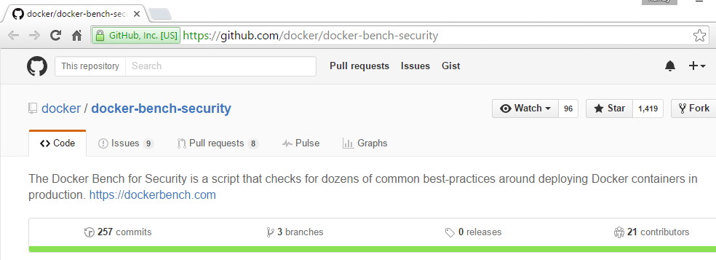
Security Best Practices
Run Docker Engine with AppArmor, SELinux or SecCompt to provide better process containment (--security-opt)
Capabilities is the default security system used by Docker engine
AppArmor profile generator for docker containers: https://github.com/jfrazelle/bane
Map groups of mutually-trusted containers to separate machines
Do not run untrusted applications with root privileges (--userns-remap)
Follow the “Principle of least privilege”
In a particular abstraction layer of a computing environment, every module (such as a process, a user or a container) must be able to access only the information and resources that are necessary for its legitimate purpose (--cap-add/drop, seccomp, or –device; never –privileged)
Resources
Center for Internet Security Benchmark for Docker 1.6+:
https://benchmarks.cisecurity.org/downloads/show-single/index.cfm?file=docker16.100
Docker Inc’s Introduction to Container Security:
https://d3oypxn00j2a10.cloudfront.net/assets/img/Docker%20Security/WP_Intro_to_container_security_03.20.2015.pdf
Docker Security Center
http://www.docker.com/docker-security
Docker Bench for Security
https://github.com/docker/docker-bench-security

Slide 27
Summary
The Linux Kernel API is organized into capabilities which can be added or dropped per container
The --privileged switch extends all capabilities, making it particularly troublesome in security conscious settings
Devices can be mapped to containers as needed
Docker --security-opts allow container processes to be constrained by AppArmor, SELinux and/or SecComp
Default is Capabilities
User name spaces allow container users to be mapped to unprivileged users on the host

Slide 28
Lab 2
Docker Security

Slide 29
3: Networking

Slide 30
Objectives
Describe the features of Docker networking
Use docker and host based commands (ex. iptables) to work with containers and networks
Describe the Docker container linking feature
Understand the basics of SDN

Slide 31
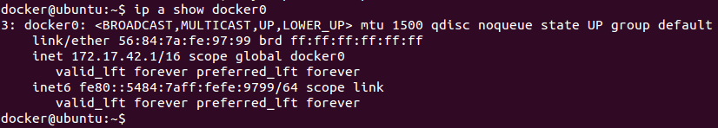
Container Networking
Docker containers expose ports which can be mapped to host interfaces so that container services are exposed on the host's external network
Docker also supports internal networking
Docker assigns containers an IP address on an isolated host based virtual network (172.17.x.x, though docker will choose an alternate subnet if there is a conflict)
Docker defines a host interface as a gateway
Docker0, usually 172.17.42.1
Containers may get new IP addresses each restart
Docker 1.5+ also supports IPv6 addresses
To enable ipv6 run the Docker daemon with the --ipv6 flag
Docker 1.9+ introduces key new container networking features
Docker can create multiple named networks (previously one net per host, docker0)
Networks can span hosts (previously each docker0 network existed on only a single host)
Containers can have multiple network interfaces (previously each container had only one network interface)
Docker networking is a large topic and covered in detail in the Advanced Docker course, more info:
$ docker network --help
https://docs.docker.com/engine/userguide/networking/dockernetworks/

Slide 32
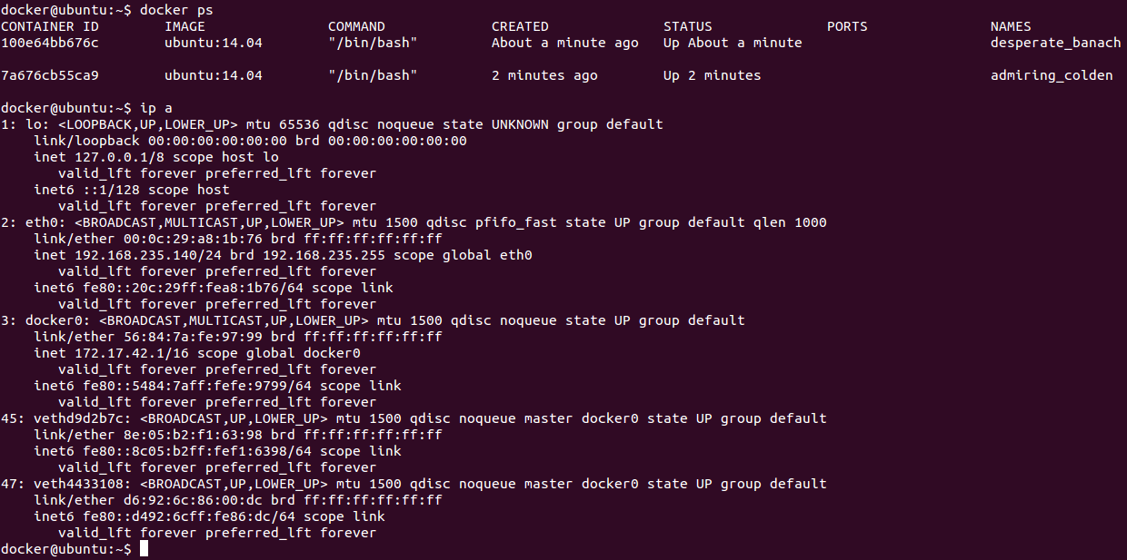
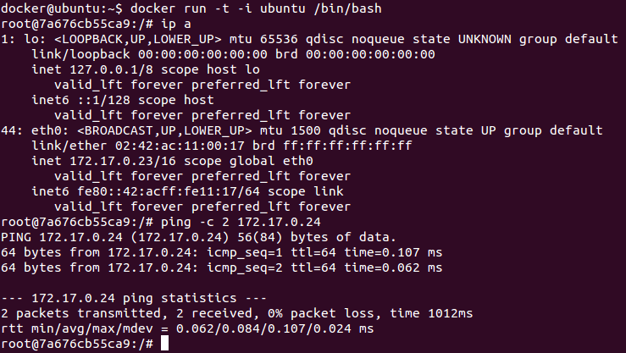
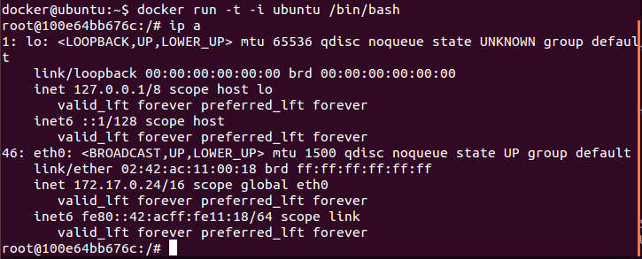
Container interfaces
Each container receives a veth (virtual Ethernet) connection to the Docker virtual network by default

Slide 33
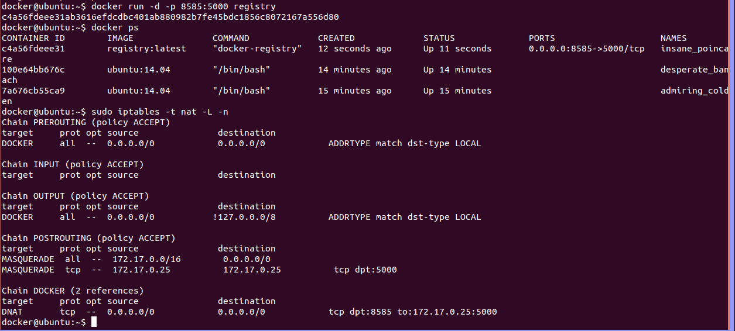
The Docker Host Interface
Docker containers access the outside world through the Host interface
The 172 network is not externally routable and must be translated using NAT/PAT
Firewall rules and NAT configuration allow Docker to route between containers and the host network
DNAT (destination based network address translation) is used to map host ports to containers

Slide 34
Port Assignment
The -p flag manages container network ports forwarding
Containers may be configured in various ways
The container ports may be internal to the container (unavailable from the host)
Docker can randomly assign a host port (49000 – 49900) to container ports
You can specify a host port for each container port
Docker can map the same port used by the container on the host interface using -P (capital P w/ no params)
The host port can be prefixed with an interface
UDP ports can be exposed by adding the /udp suffix
The port command displays port details (similar to the ps command)
For example the docker “registry” image specifies the EXPOSE 5000 instruction
The session below demonstrates three possible port mapping styles
docker@ubuntu:~$ docker run -d registry
913120c8f3c3f40968079e70f4b758618ecf95a9d234337841ff09cf688a7494
docker@ubuntu:~$ docker ps
CONTAINER ID IMAGE COMMAND CREATED STATUS PORTS NAMES
913120c8f3c3 registry:latest "docker-registry" 4 seconds ago Up 3 seconds 5000/tcp berserk_carson
docker@ubuntu:~$ docker stop 913120c8f3c3
913120c8f3c3
docker@ubuntu:~$ docker run -d -p 5000 --name="regtest" registry
55af8926ce3ea511b2357d4dc9e750018ff72a177457fab5991650f1dc73b777
docker@ubuntu:~$ docker ps
CONTAINER ID IMAGE COMMAND CREATED STATUS PORTS NAMES
55af8926ce3e registry:latest "docker-registry" 3 seconds ago Up 2 seconds 0.0.0.0:49154->5000/tcp regtest
docker@ubuntu:~$ docker stop regtest
regtest
docker@ubuntu:~$ docker rm regtest
regtest
docker@ubuntu:~$ docker run -d -p 127.0.0.1:8585:5000 --name="regtest" registry
9ad870687ebf53381da6ae51c1c4ae09cddb03a8a33d6d17c0ef817bdc4dc36e
docker@ubuntu:~$ docker ps
CONTAINER ID IMAGE COMMAND CREATED STATUS PORTS NAMES
9ad870687ebf registry:latest "docker-registry" 14 seconds ago Up 13 seconds 127.0.0.1:8585->5000/tcp regtest
docker@ubuntu:~$ docker port regtest
5000/tcp -> 127.0.0.1:8585
Metadata created by EXPOSE
Docker port mapping reference
http://docs.docker.com/userguide/dockerlinks/#network-port-mapping-refresher

Slide 35
Linking Containers
Inter-Container Communications
Docker containers can use external services via MASCARADE rules
Docker containers can expose services externally using DNAT rules
Docker containers can also be linked directly using Docker virtual networks
Container naming
Named containers on the same virtual network can discover each other by name (via /etc/hosts as of Docker v1.9 and via DNS as of Docker 1.10)
The docker run --link flag is used to create container aliases
For example:
$ sudo docker run -d --name dbsvr train/postgres
$ sudo docker run -d -P --name web --link dbsvr:db train/webapp python app.py
“-P” (uppercase P) switch publishes the container EXPOSE port(s) directly on the host with random ephemeral ports
The --link switch takes the form: --link <name or id>:alias
“name” is the container to link to and “alias” is a resolvable name for the target container within the client container
Prior to Docker 1.10 the --link switch was only supported on the Docker0 Host network (in Docker 1.10+ link aliases can be created between any two containers on the same network)
Inter-container connections do not require externally exposed ports
Note the db container was started without -P or -p

Slide 36
Link /etc/hosts and ENV updates
Prior to Docker v1.10
Host files
When two containers are linked Docker adds a host entry for the source container to the /etc/hosts file
$ sudo docker run -it --rm --link dbsvr:db training/webapp /bin/bash
root@aed84ee21bde:/opt/webapp# cat /etc/hosts
172.17.0.7 aed84ee21bde #the web app itself
. . .
172.17.0.5 db #the linked db container
Discussion is underway around changing discovery to a DNS function embedded in the Docker Engine
Environment Variables
When two containers are linked Docker adds environment variables in the client container also
$ sudo docker run -it --rm --link dbsvr:db training/webapp /bin/bash
root@aed84ee21bde:/opt/webapp# env
. . .
DB_NAME=/web2/db
DB_PORT=tcp://172.17.0.5:5432
DB_PORT_5432_TCP=tcp://172.17.0.5:5432
DB_PORT_5432_TCP_PROTO=tcp
DB_PORT_5432_TCP_PORT=5432
DB_PORT_5432_TCP_ADDR=172.17.0.5
Docker v1.10+
Docker v1.10 updates /etc/hosts for containers on the Docker0 network for backwards compatibility
Containers on user defined networks now use a Docker daemon supplied DNS server to lookup other containers
Links simply add additional aliases for containers

Slide 37
docker network [new in Docker v1.9]
user@ubuntu:~$ docker help network
Usage: docker network [OPTIONS] COMMAND [OPTIONS]
Commands:
connect Connect container to a network
disconnect Disconnect container from a network
inspect Display detailed network information
ls List all networks
rm Remove a network
create Create a network
Run 'docker network COMMAND --help' for more information on a command.
user@ubuntu:~$ docker network create dbnet
83303b4072a01a643b0e528004455ea1dea0d82e34b8d0acaee294ecda140f2c
user@ubuntu:~$ docker run -itd --net dbnet busybox
5932b33e6932cb04653bfdc89c25a06791e4e8837fb3447075436b85a3266a28
user@ubuntu:~$ docker attach 593
/ # ip a
1: lo: <LOOPBACK,UP,LOWER_UP> mtu 65536 qdisc noqueue
link/loopback 00:00:00:00:00:00 brd 00:00:00:00:00:00
inet 127.0.0.1/8 scope host lo
valid_lft forever preferred_lft forever
inet6 ::1/128 scope host
valid_lft forever preferred_lft forever
5: eth0: <BROADCAST,MULTICAST,UP,LOWER_UP> mtu 1500 qdisc noqueue
link/ether 02:42:ac:12:00:02 brd ff:ff:ff:ff:ff:ff
inet 172.18.0.2/16 scope global eth0
valid_lft forever preferred_lft forever
inet6 fe80::42:acff:fe12:2/64 scope link
valid_lft forever preferred_lft forever
/ #
user@ubuntu:~$ docker network ls
NETWORK ID NAME DRIVER
0a7f3161920b bridge bridge
06f242ff03bc none null
58f86e1e475a host host
83303b4072a0 dbnet bridge
user@ubuntu:~$ docker network inspect dbnet
[{
"Name": "dbnet",
"Id": "83303b4072a01a643b0e528004455ea1dea0d82e34b8d0acaee294ecda140f2c",
"Scope": "local",
"Driver": "bridge",
"IPAM": {
"Driver": "default",
"Config": [{}]
},
"Containers": {
"5932b33e6932cb04653bfdc89c25a06791e4e8837fb3447075436b85a3266a28": {
"EndpointID": "7cc094e49339aff88a934b6092d96c8cf9fe18bba6dbd…",
"MacAddress": "02:42:ac:12:00:02",
"IPv4Address": "172.18.0.2/16",
"IPv6Address": ""
}
},
"Options": {}
}]
docker network
ls – list the networks available
create – creates a new virtual network
--internal
rm – removes an existing virtual network
inspect – displays network information
connect – connects an existing container to the specified network
disconnect – disconnects an existing container from the specified network
Docker 1.9 allows containers to connect to multiple networks
eth0, eth1, etc.
Network drivers (-d <driver>)
none – loopback only
host – no container network namespace
bridge – Linux bridge (only available on the host it is created on)
overlay – allows networks to span multiple hosts using VXLAN, requires a key/value store (etcd, Consul or ZooKeeper)

Slide 38
Summary
Docker uses the built in features Linux to perform basic networking functions
IP Tables
Linux Bridge
The docker run -p switch provides a range of port mapping features
The docker run --link switch creates a caller based alias for a destination container name
Docker offers a plug in system (CNM – common network model) supported by libnetwork which can be used to enable multihost networking and a range of SDN network systems

Slide 39
Lab 3
Working with Networks

Slide 40
4: Swarm

Slide 41
Objectives
Explain the basic features of container orchestration
Describe the container orchestration ecosystem
Contrast Swam and Swarm Mode
List the features of Swarm

Slide 42
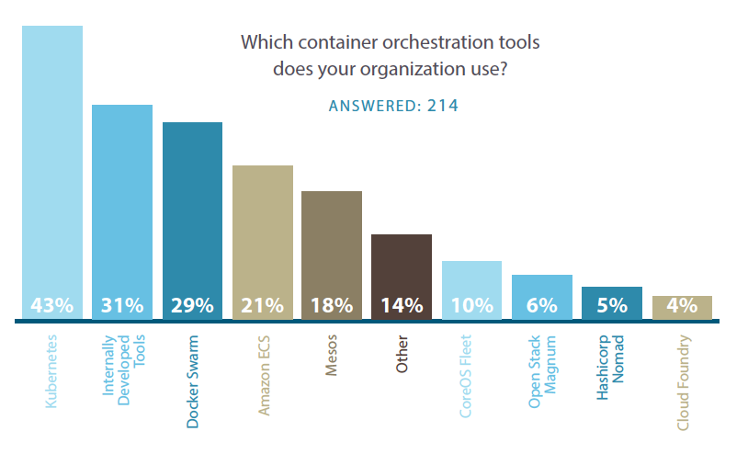
Container Orchestration
Container Orchestration
Distribution and management of containers across a networked cluster of servers
Orchestration Tools
Docker Swarm
Docker authored native clustering for Docker containers
Also now Docker Data Center, built on Docker Universal Control Plane (Tutum)
Kubernetes
Google authored open-source platform for automating deployment, scaling, and operations of application containers across clusters of hosts
The EngineYard Deis PaaS is based on Kubernetes
Apache Mesos
A distributed system kernel which abstracts CPU, memory, storage, and other compute resources away from machines (physical or virtual), enabling fault-tolerant and elastic distributed systems to easily be built and run effectively
Mesos 0.20.0 shipped with built in Docker support (0.27 released 1/31/2016)
Cloud Foundry Diego
Elastic runtime written in Go supporting the Garden container manager and runC
Well integrated with OpenStack among other platforms
Configuration Management Platforms
Various CM platforms can be used to deploy and maintain containers (considered a clunky/static solution by many)
Ansible, Chef, Puppet, Capistrano, …
Other cluster scheduling systems:
Mesosphere Marathon
Twitter Aurora for Mesos (now Apache Aurora)
Facebook Tupperware (fairly proprietary/LXC)
Cloud Support
Google Container Engine
Optimized VMs with Kubernetes preinstalled
Amazon EC2 Container Service allows Docker containers to be deployed on AWS EC2
OpenStack Havana supports Docker as a Hypervisor
Ubuntu adds beta support for lxc containers in Juno/Kilo with their new lxd “lightvisor” (enabling multitenant caliber system containers within which Docker can run)
Magnum is an OpenStack project making container orchestration engines (Docker Swarm and Kubernetes) available
November 2014 Microsoft pledged to fully integrate Docker with Windows Server and Azure
.Net containers demoed at Build conference 4/2015
Windows Server 2016 will ship with a native Docker Engine API compatible container service
https://clusterhq.com/assets/pdfs/state-of-container-usage-june-2016.pdf

Slide 43
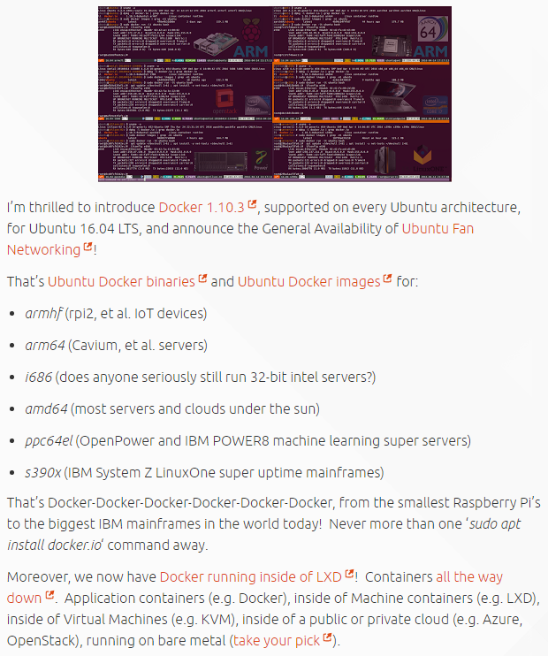
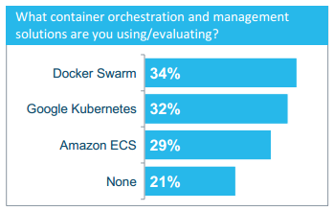
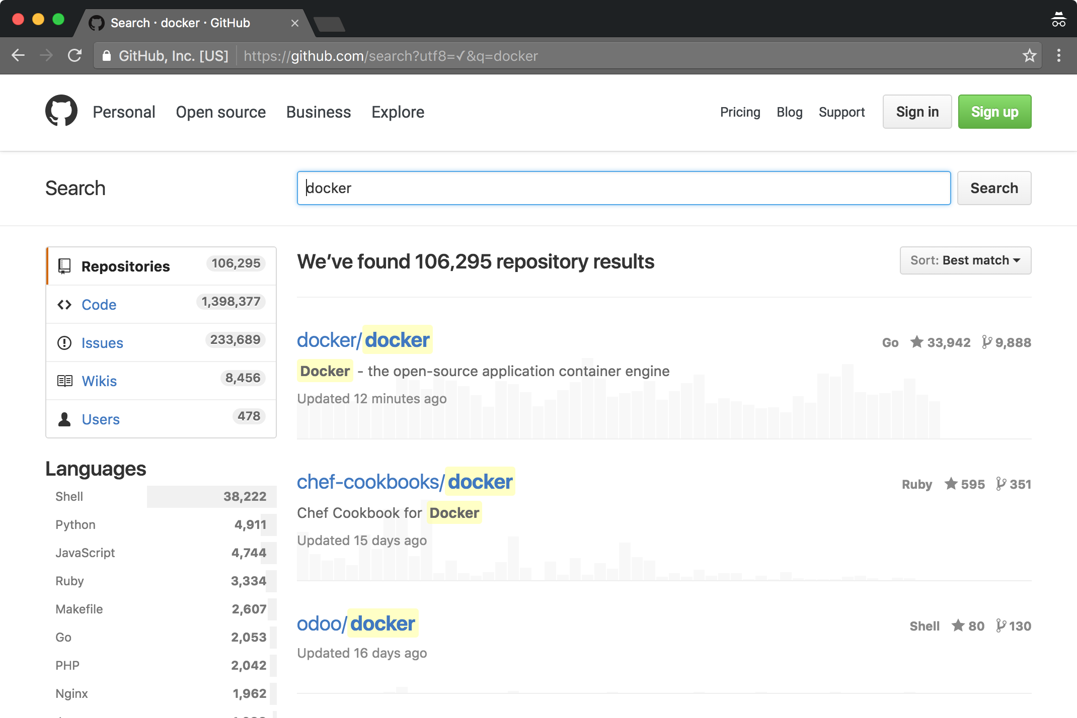
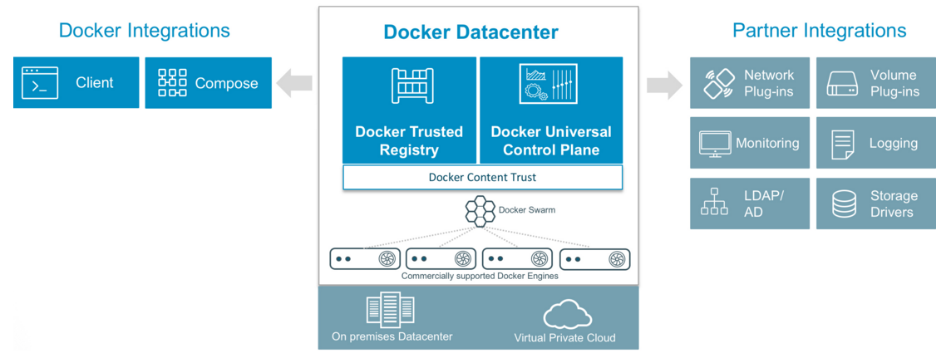
Docker EcoSystem
Docker Inc. offers a suite of orchestration services
Docker Machine configures Docker on cloud servers
Docker Compose multi-container app deployment (uses YAML templates)
Docker Swarm container cluster service
Docker Trusted Registry on prem Docker Hub
Docker Universal Control Plane container deployment
Tutum, acquired 2015, renamed Universal Control Plane, offers LDAP/AD integrated container deployment/management
Docker Datacenter (UCP and Trusted Reg)
Docker Cloud (UCP and Trusted Reg as a Service++)
Github reports over 100,000+ Docker projects
Google Kubernetes (http://kubernetes.io/) is a widely supported open source container orchestration service
Supports scheduling and packaging containers (including Docker) onto nodes using Pods
Google offers container optimized VMs in their cloud
Apache Mesos (http://mesos.apache.org/) allows compute clusters to be managed like a single system
Mesos kernel runs on every machine providing applications with API’s for resource management and scheduling across entire datacenter and cloud environments
Mesosphere Marathon and Apache Aurora enable container deployment on top of Apache Mesos at scale
Amazon EC2 Container Service allows Docker containers to be deployed on AWS EC2
Microsoft integrated Docker with Windows and Azure
Windows 2016 and Windows 10
https://www.docker.com/microsoft
https://msdn.microsoft.com/en-us/virtualization/windowscontainers/docker/configure_docker_daemon
Azure
https://azure.microsoft.com/en-us/services/container-service/
OpenStack Havana supports Docker as a Hypervisor
Ubuntu lxc container support added in Juno, via lxd “lightvisor” (enabling multitenant caliber system containers which can run Docker [challenging Ironic])
Magnum is an OpenStack project making container orchestration engines (Docker Swarm, Kubernetes and Mesos) available
Docker 3/2016 Survey

Slide 44
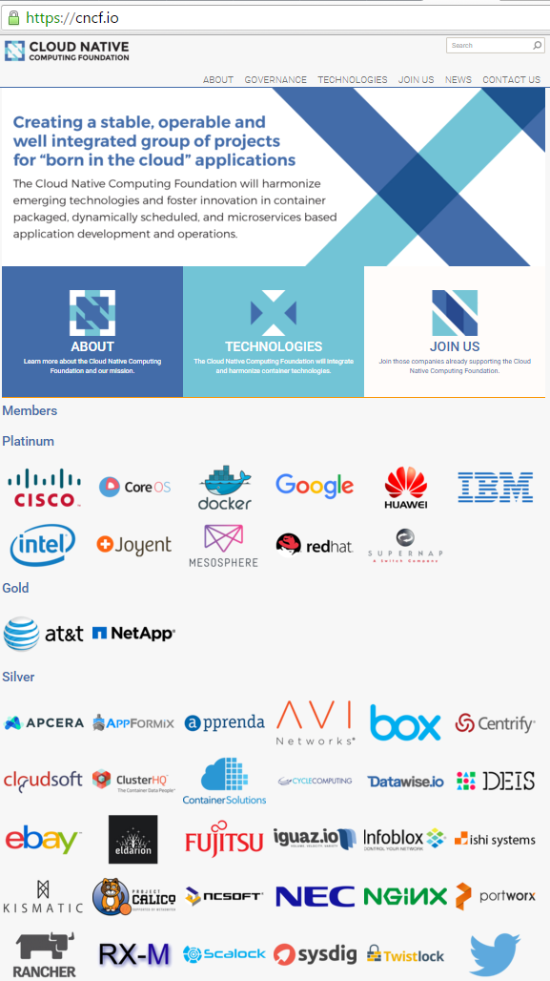
Container Orchestration Initiatives
CNCF [circa 7/2015]
Container Native Computing Foundation
Hosted by the Linux Foundation
Cloud Native Applications are: container packaged, dynamically managed and micro-services oriented
Mission: To create and drive the adoption of a new set of common container technologies informed by technical merit and end user value, and inspired by Internet-scale computing
Aims to host the reference stack of technologies around container orchestration
Google has handed Kubernetes over to the foundation
The Prometheus monitoring platform has also been moved under the foundation
Members include:
AT&T, Box, Cisco, CloudFoundry, CoreOS, Cycle Computing, Docker, eBay, Fujitsu, Goldman Sachs, Google, Huawei, IBM, Intel, Joyent [Samsung], Kismatic, Mesosphere, Odin, RedHat, RX-M LLC, Supernap, Sysdig, Twistlock, Twitter, Univa, VMWare, Weaveworks

Slide 45
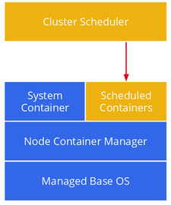
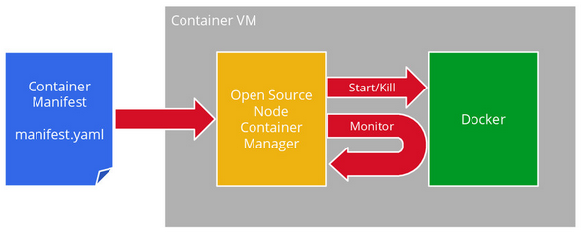
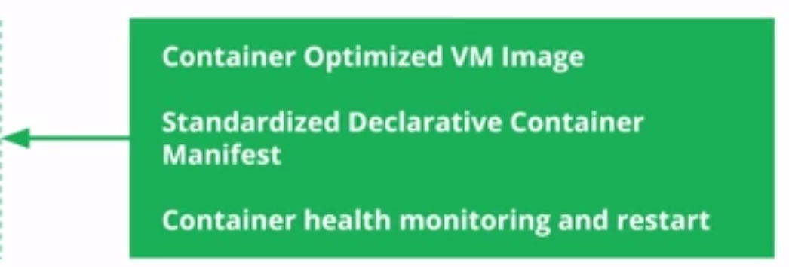
Containers at scale
Containers - a key enabler of PaaS cloud environments
Google App Engine is one of the most visible container based cloud systems
Everything at Google, from Search to Gmail, is packaged and run in a Linux container
Google’s Borg system (the basis for Kubernetes) is a cluster manager that ran hundreds of thousands of jobs, from many thousands of different containerized applications, across a number of clusters each with up to tens of thousands of machines (Borg is now replaced within Google by the next gen Omega system)
Over 2 billion containers are started per week at Google (over 3,000 per second on average)
lmctfy ("Let Me Contain That For You“) open source version of Google’s container stack
Google has ported the core lmctfy concepts and abstractions to Docker’s libcontainer
libcontainer is now the basis for much of the OCI container standard
Google Container
Infrastructure
Google Cloud Platform
Docker containers in Google Compute Engine
Containers At Scale by Joe Beda
Published May 22, 2014 in Technology
Borg Paper: https://static.googleusercontent.com/media/research.google.com/en//pubs/archive/43438.pdf Omega Paper: http://static.googleusercontent.com/media/research.google.com/en//pubs/archive/41684.pdf

Slide 46
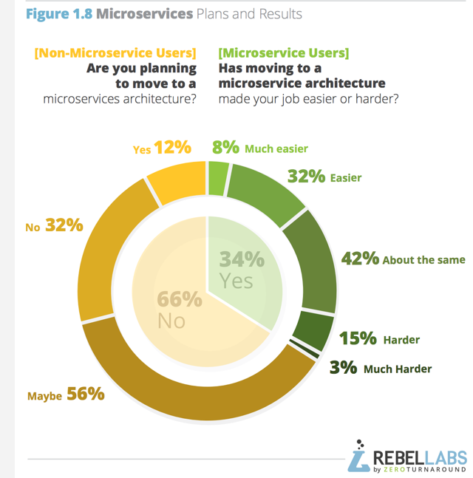
Who’s using Microservices?
Moving to microservices is not a silver bullet
40% find it easier
42% find no change
18% find it harder
The right tools for orchestration are a critical factor in this outcome

Slide 47
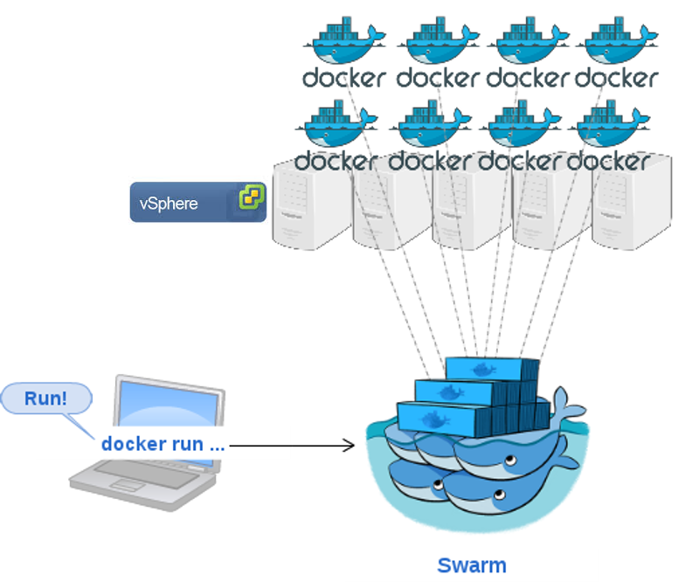
Swarm
Docker Swarm offers native clustering for Docker
Swarm offers access a pool of Docker hosts using Docker tools
Docker Swarm exposes the standard Docker Remote API
Any tool that already communicates with a Docker daemon can use Swarm to transparently scale to multiple hosts
Swarm also provides extensions through he Swarm API
Supported tools include, but are not limited to, the following:
Dokku
Docker Compose
Docker Machine
Jenkins
As initial development settles, an API will develop to enable pluggable backends
This means you can swap out the scheduling backend Docker Swarm uses more powerful backends, like Mesos

Slide 48
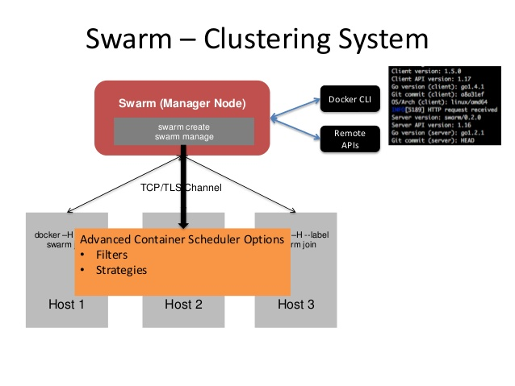
Swarm Creation
The first step to creating a swarm on your network is to pull the Docker Swarm image
Then, using Docker, you configure the swarm manager and all the nodes to run Docker Swarm
Manual install:
Open a TCP port on each node for communication with the swarm manager
Install Docker on each node
Create and manage TLS certificates to secure your swarm (for test this is optional)
docker-machine can also install swarm automatically
Using Docker Machine, you can quickly install a Docker Swarm on cloud providers or inside your own data center
If you have VirtualBox installed on your local machine, you can quickly build and explore Docker Swarm in your local environment with machine
This method automatically generates a certificate to secure your swarm

Slide 49
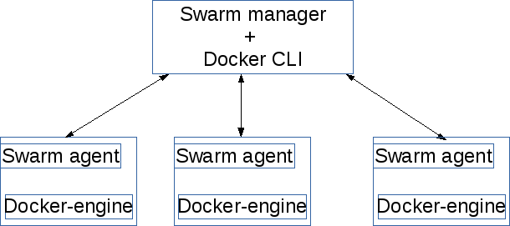
Swarm Services
Each Swarm node will run a Swarm node agent
The agent registers the referenced Docker daemon, monitors it, and updates the discovery backend with the node’s status
The Swarm Manager runs on any node and provides the Docker Remote API for the cluster
All nodes in a swarm cluster must listen on the same TCP port
docker -H tcp://192.168.235.149:2375 run -d –p 7777:2375 swarm manage token://63cd50227b39739aa8c592cff48c836c
docker -H tcp://192.168.235.149:2375 run -d swarm join --addr=192.168.235.149:2375 token://63cd50227b39739aa8c592cff48c836c

Slide 50
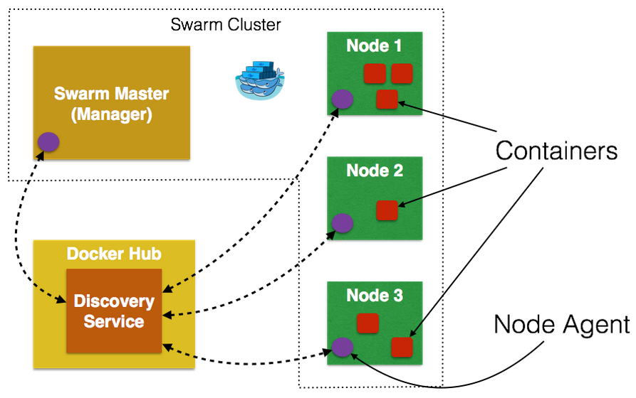
Node Discovery
The Swarm Manager can discover cluster nodes in various ways
Docker Hub Tokens
Docker Hub hosts a node discovery service using tokens to identify nodes in a cluster
$ swarm create #produces a cluster token, e.g.: 6856663cdefdec325839a4b7e1de38e8
$ swarm manage -H tcp://10.0.0.7:2375 token://6856663cdefdec325839a4b7e1de38e8
The -H switch specifies the ip:port the swarm manager will listen on
Static configuration file
$ swarm manage -H tcp://10.0.0.7:2375 file:///data/my_cluster
Key/value stores
Etcd
swarm manage \ -H tcp://10.0.0.7:2375 \ etcd://<etcd_ip>/<path>
Consul
swarm manage \ -H tcp://10.0.0.7:2375 \ consul://<consul_addr>/<path>
Zookeeper
swarm manage \ -H tcp://10.0.0.7:2375 \ zk://<zookeeper_addr1>, \ <zookeeper_addr2>/<path>
Nodes join dynamically using --advertise
$ swarm join \ --advertise=10.0.0.7:2375 \ token://6856663cdefdec32…
$ swarm join \ --advertise=10.0.0.7:2375 \ etcd://<etcd_ip>/<path>
…
Not used for file based configuration
Nodes are simply listed in the file by ip:port

Slide 51
Swarm Scheduler
Swarm support three scheduling strategies
Binpack – schedules to the same node until the node is saturated then moves to the next node
Spread – (default) schedules to the node with the fewest containers
Random - random
The Docker Swarm scheduler comes with multiple filters
The following filters are currently used to schedule containers on a subset of nodes:
Constraint
Affinity
Port
Dependency
Health
You can choose the filter(s) you want to use with the --filter flag of swarm manage
Constraint Filter Example
Constraints are key/value pairs associated to particular nodes, you can see them as node tags
When creating a container, the user can select a subset of nodes that should be considered for scheduling by specifying one or more sets of matching key/value pairs
This approach has several practical use cases such as:
Selecting specific host properties (such as storage=ssd, in order to schedule containers on specific hardware)
Tagging nodes based on their physical location (region=us-east, to force containers to run on a given location)
…
For instance, start node-1 with the storage=ssd label:
$ docker daemon --label storage=ssd
$ swarm join --advertise=192.168.0.42:2375 token://XXXXXXXXXXXXXXXXXX
Again, but this time node-2 with storage=disk:
$ docker daemon --label storage=disk
$ swarm join --advertise=192.168.0.43:2375 token://XXXXXXXXXXXXXXXXXX
Once the nodes are registered with the cluster, the master pulls their respective tags and will take them into account when scheduling new containers

Slide 52
High availability in Docker Swarm
In a Swarm cluster the swarm manager is responsible for the entire cluster and manages the resources of multiple Docker hosts
If the swarm manager dies, you must create a new one and deal with an interruption of service
The High Availability feature allows a Docker Swarm to gracefully handle the failover of a manager instance
Using this feature, you can create a single primary manager instance and multiple replica instances
A primary manager is the main point of contact with the Docker Swarm cluster
You can also create and talk to replica instances that will act as backups
Requests issued on a replica are automatically proxied to the primary manager
If the primary manager fails, a replica takes over as the new primary
Swarm relies on third party solutions to implement the failover manager clustering functionality
Supported solutions:
Consul
Etcd
Zookeeper

Slide 53
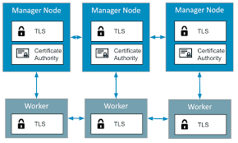
Swarm Mode
Docker Engine v1.12.0 added support for “Swarm Mode”
mode for natively managing a cluster of Docker Engines
Allows you to use the Docker CLI to:
create a swarm
deploy application services to a swarm
manage swarm behavior
Features
Integrated with Docker Engine, no additional orchestration software needed to create or manage a swarm
Decentralized design, you can deploy managers and workers using the Docker Engine
Declarative service model, lets you define the desired state of services in your application stack
Scaling, you can declare the instance count for each service
Desired state reconciliation, the swarm manager node monitors the cluster state and reconciles any differences between the actual state your expressed desired state
Multi-host networking, you can specify an overlay network for your services and your swarm manager will then automatically assigns addresses to the containers on the overlay network when it initializes or updates them
Service discovery, the Swarm manager nodes assign each service in the swarm a unique DNS name and load balances running containers
Load balancing, you can expose the ports for services to an external load balancer, internally, the swarm lets you specify how to distribute service containers between nodes
Secure by default, each node in the swarm enforces TLS mutual authentication and encryption to secure communications between itself and all other nodes
Rolling updates, you can apply service updates to nodes incrementally, the swarm manager lets you control the delay between service deployment to different sets of nodes, if anything goes wrong, you can roll-back a task to a previous version of the service

Slide 54
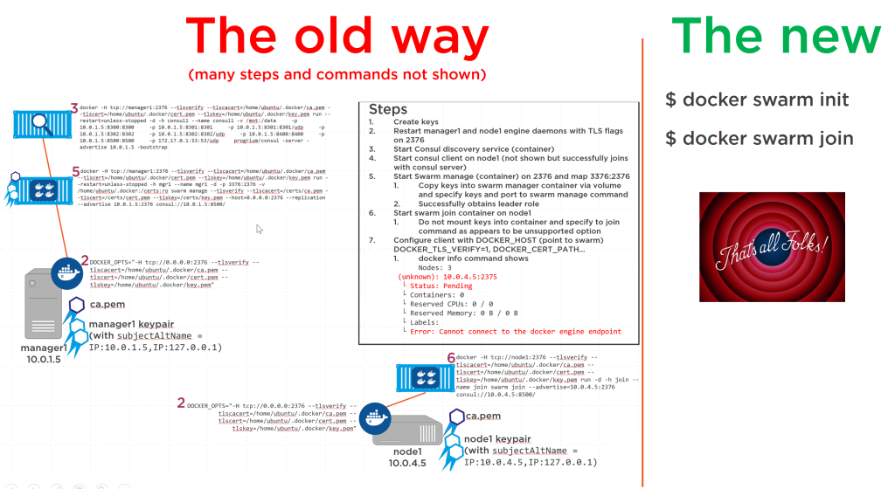
docker swarm & service subcommands
swarm init
swarm join
service create
service inspect
service ls
service rm
service scale
service ps
service update

Slide 55
Concepts
Swarm
A swarm is a cluster of Docker Engines where you deploy services
The cluster management and orchestration features embedded in the Docker Engine (built using SwarmKit)
Engines participating in a cluster are running in swarm mode
You enable swarm mode for the Engine by either initializing a swarm or joining an existing swarm
When you run Docker Engine outside of swarm mode, you execute container commands, when you run the Engine in swarm mode, you orchestrate services.
Node
A node is an instance of the Docker Engine participating in a swarm
To deploy your application to a swarm, you submit a service definition to a manager node
The manager node dispatches units of work called tasks to worker nodes
Manager nodes elect a single leader to conduct orchestration tasks (recovery, scaling, rollout, etc.)
Worker nodes receive and execute tasks dispatched from manager nodes (by default manager nodes are also worker nodes, but you can configure managers to be manager-only)
Services and tasks
A service is the definition of the tasks to execute on the worker nodes
It is the central structure of the swarm system and the primary root of user interaction with the swarm
When you create a service, you specify which container image to use and which commands to execute inside running containers
In the replicated services model, the swarm manager distributes a specific number of replica tasks among the nodes based upon the scale you set in the desired state
For global services, the swarm runs one task for the service on every available node in the cluster
A task carries a Docker container and the commands to run inside the container, it is the atomic scheduling unit of swarm
Once a task is assigned to a node, it cannot move to another node
Load balancing
The swarm manager uses ingress load balancing to expose the services you want to make available externally to the swarm
The swarm manager can automatically assign the service a PublishedPort or you can configure a PublishedPort for the service in the 30000-32767 range
External components, such as cloud load balancers, can access the service on the PublishedPort of any node in the cluster whether or not the node is currently running the task for the service
All nodes in the swarm route ingress connections to a running task instance
Swarm mode has an internal DNS component that automatically assigns each service in the swarm a DNS entry
The swarm manager uses internal load balancing to distribute requests among services within the cluster based upon the DNS name of the service

Slide 56
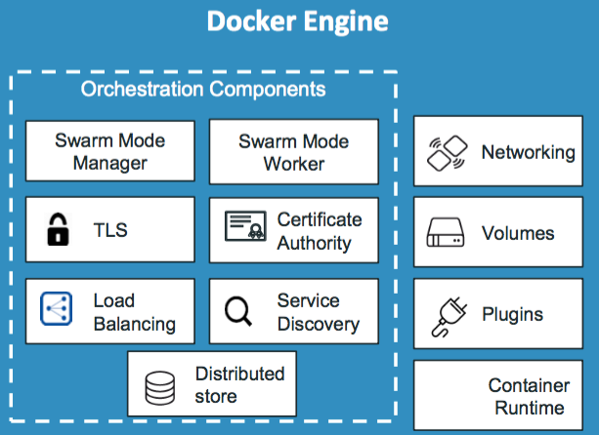
Swarm Components
user@ubuntu:~$ docker service create nginx
141z2ky40mq8zxv7d7soynfxp
user@ubuntu:~$ docker service ls
ID NAME REPLICAS IMAGE COMMAND
141z2ky40mq8 awesome_babbage 1/1 nginx
user@ubuntu:~$ docker service scale 141z=2
141z scaled to 2
user@ubuntu:~$ docker service ls
ID NAME REPLICAS IMAGE COMMAND
141z2ky40mq8 awesome_babbage 2/2 nginx
user@ubuntu:~$
user@ubuntu:~$ docker swarm init --advertise-addr=10.0.0.220
Swarm initialized: current node (e7n1dpk4axdiyoo2mx4r2tb1r) is now a manager.
To add a worker to this swarm, run the following command:
docker swarm join \
--token SWMTKN-1-0wpinu43yhdm5zkwbtoagqvhgpcekuyl4s2bmzeevksf0tx3fi-9k6q6w4osrj4s6000p50l8q1n \
10.0.0.220:2377
To add a manager to this swarm, run the following command:
docker swarm join \
--token SWMTKN-1-0wpinu43yhdm5zkwbtoagqvhgpcekuyl4s2bmzeevksf0tx3fi-0nf4ddcnixz0rbv4ebjl25p3k \
10.0.0.220:2377

Slide 57
Summary
Production container orchestration systems offer a range of critical services for microservice based applications
Scaling
Rollout
Recovery
Deployment
Load balancing
Service Discovery
Key orchestration players include Kubernetes, Marathon/Mesos, Aruora/Mesos, and Swarm
Swarm Mode is the new integrated Swarm functionality in Docker 1.12
Swarm makes clusters as easy as Docker makes containers

Slide 58
Lab 4
Docker Swarm Mode

Slide 59
The End
Many thanks for attending!

Slide 60
Appendix
Additional topics of interest for your reference
Links
Books
Docker GUIs
Migrating native systems into containers
Changing File System Drivers

Slide 61
Docker Best Practices
Design containers to be ephemeral
You should be able to terminated and restart containers with no concern for their state
You should “move” containers between hosts by terminating the container on the source host and running a new container from the image on the target host (no need to move stateless services)
Design each container to run a single service
Container technology works best with microservice oriented, cloud native designs (though it can be greatly beneficial in other application architectures as well)
Commands like docker signal and ps interact with the PID 1 process
Use Dockerfiles to build images
Docker commit is great for experimentation and debugging but does not build an “Infrastructure as Code” style repeatable process
Dockerfile build operations can be cleanly integrated into existing CI/CD pipelines
Use Volumes Appropriately
Volumes can be shared between containers using --volumes-from
Use volumes to share a directory between containers and when writing large amounts of data to a directory
Containers should be stateless, application state belongs in volumes, independent of containers and container lifespans
Use the Data Container Pattern with Volumes
Volumes are reference counted and deleted when no longer used by a container when “docker rm -v” is used
A dedicated (empty) Data Container associated with such a volume allows the volume to have a life span independent of the other ephemeral containers using the volume
The Data Container associated with the disk volume need not ever be run for other containers to use the volume
The Data Container allows the underlying volume to be encapsulated, hiding details from other containers (which use --volumes-from to access the Data Container’s volumes)
Base Data Containers on the same image the running containers which access the VOLUME use
Post Docker v1.9 “docker volume” can be used instead to create shared volumes using volume drivers or host volumes
Docker managed host paths are deprecated
Choose a minimum permissions User [in Docker v1.10 ROOT is a minimum permission user!!]
Pre Docker 1.10
By default docker containers run as root with full control of the host system prior to Docker v1.10
Use the USER instruction to specify a non-root user for containers to run as
You can create the users and groups you need in the Dockerfile
Images inherit their parent image’s USER, override the parent image USER with a local USER statement when appropriate
Docker 1.10 adds user namespaces allowing root to be used safely within containers
This is the best of both worlds (root has full control in the container and no control outside)
This must be enabled with the daemon switch --userns-remap and a supporting kernel
With user namespaces ROOT is a perfectly acceptable inside container user
Much borrowed from Project Atomic: http://www.projectatomic.io/docs/docker-image-author-guidance/

Slide 62
Anti Patterns
Stateful containers
Use volumes for state and isolate state management in the appropriate microservice tier
Shipping containers
Containers should be ephemeral, images are the unit of distribution, ship images not containers
Large images
Production images should be small and easy to push/pull, only including what is needed
Too few or too many filesystem layers
You should probably have an OS layer (e.g. Centos:7), a runtime layer (e.g. nodejs) and an app layer (e.g. your js code) to simplify and speed changes and updates, to few layers makes builds and patches expensive, too many slows down union filesystem driver operation
Build automation with docker commit
Commit is best suited for ad hoc experiments, repeatable projects builds should be managed with Dockerfiles
Multiple concerns in a single container
Containers are best suited for packaging microservices
SSH in a container
(see above) Containers should be managed from the outside not the inside and treated like services not systems
Relying on the latest tag
Always explicitly choose a base image: “FROM ubuntu:14.04.3” -- not --- “FROM ubuntu”
Storing credentials/secrets in an image/container
Environment variables are the best way to set secrets, keeping sensitive data out of source code and off disk
Depending on specific IP addresses
Many virtual networking technologies are at plat today and specific IP address assignment is a brittle approach, use service discovery mechanisms to find dependencies at runtime
Restarting or moving containers
Containers should be ephemeral, never restart a container (on the same node or a different node)
To “move” a container from one host to another you should terminate and delete the container on host A and start a new copy of the image on host B
Much borrowed from Rafael Benevides & Erik Dasque

Slide 63
Links
Docker homepage - https://www.docker.com/
Docker Hub - https://hub.docker.com
Docker blog - http://blog.docker.com/
Docker documentation - https://docs.docker.com/
Docker code on GitHub - https://github.com/docker/docker
Docker Forge - https://github.com/dockerforge
Collection of Docker tools, utilities, and services
Docker mailing list - https://groups.google.com/forum/#!forum/docker-dev
Docker on IRC: irc.freenode.net channel #docker
Docker on Twitter - #docker
StackOverflow - http://stackoverflow.com/tags/docker
Docker Cheat Sheet - https://github.com/wsargent/docker-cheat-sheet
Docker & Jenkins - https://www.youtube.com/watch?v=7K-8SFmVDlM
Getting Started with Docker - https://dzone.com/refcardz/getting-started-with-docker-1
Overlay network options - http://www.slideshare.net/syed1/docker-meetup-52918010

Slide 64
Books
The Docker Book, Turnbull
http://www.dockerbook.com/
O’Reilly Books:
Docker Up and Running
Docker Cookbook
Using Docker
Manning Books
Docker in Action
Docker in Practice

Slide 65
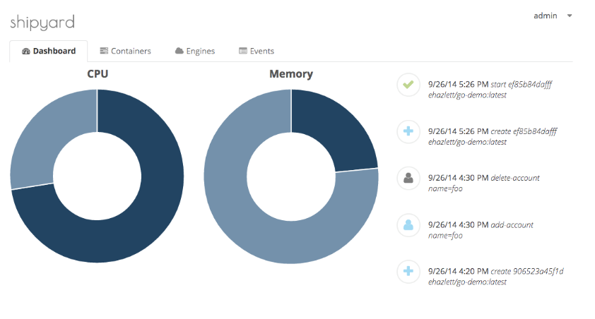
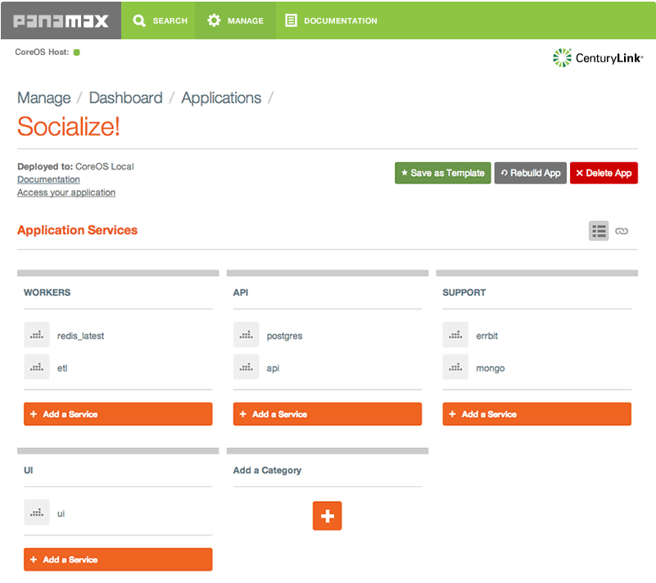
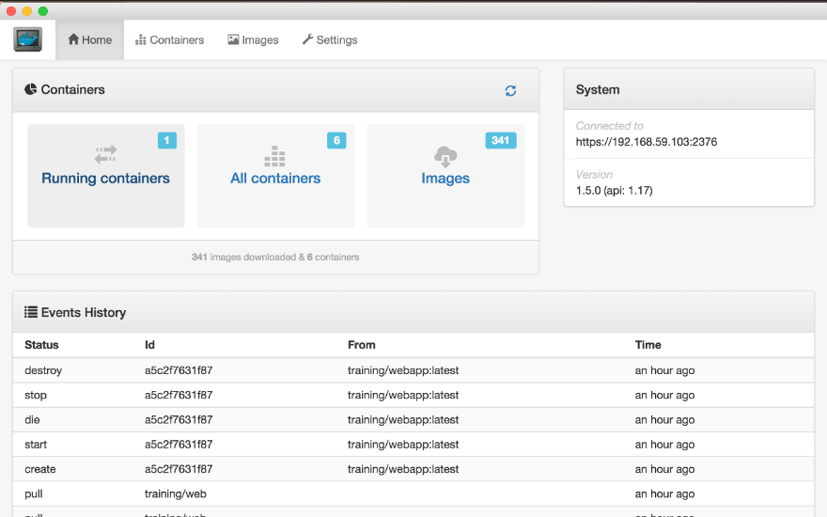
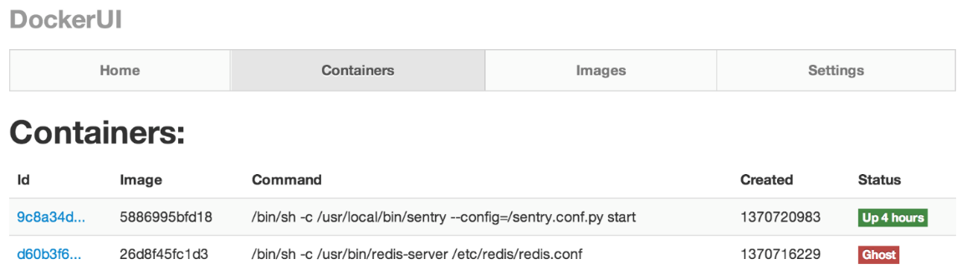
Docker UIs
There are several web UIs available for Docker
Kitematic – Acquired by Docker and provided as part of Docker Toolbox, desktop container management
Tutum (now Docker Control Plane) – Enterprise targeted container deployment and management [subscription based Docker product]
Shipyard – supports management of Docker hosts and containers (built on the Citadel cluster management toolkit)
Provides web and CLI interfaces
http://shipyard-project.com
Panamax – web based containerized application management based on Fleet
http://panamax.io/
Simple Docker UI for Chrome
https://github.com/felixgborrego/docker-ui-chrome-app
DockerUI - a web interface for the Docker Remote API
https://github.com/crosbymichael/dockerui

Slide 66


Turning a Snowflake into a Phoenix
Snowflake servers have one of a kind configurations
Modified directly by admins over time
The server’s configuration is not easy to reproduce
Not a good basis for modern IaC (Infrastructure as Code)
Phoenix servers can be destroyed and restarted from a base over and over again
Like containers launched from images/Dockerfiles or VMs launched from a snapshot or nodes built from a Puppet manifest or a Chef recipe
There are several ways you can generate a Docker image from a running snowflake system
Tar the entire file system and use docker import to create an image from the tarball
Use blueprint or other similar tools
https://zwischenzugs.wordpress.com/2015/05/24/convert-any-server-to-a-docker-container/

Slide 67
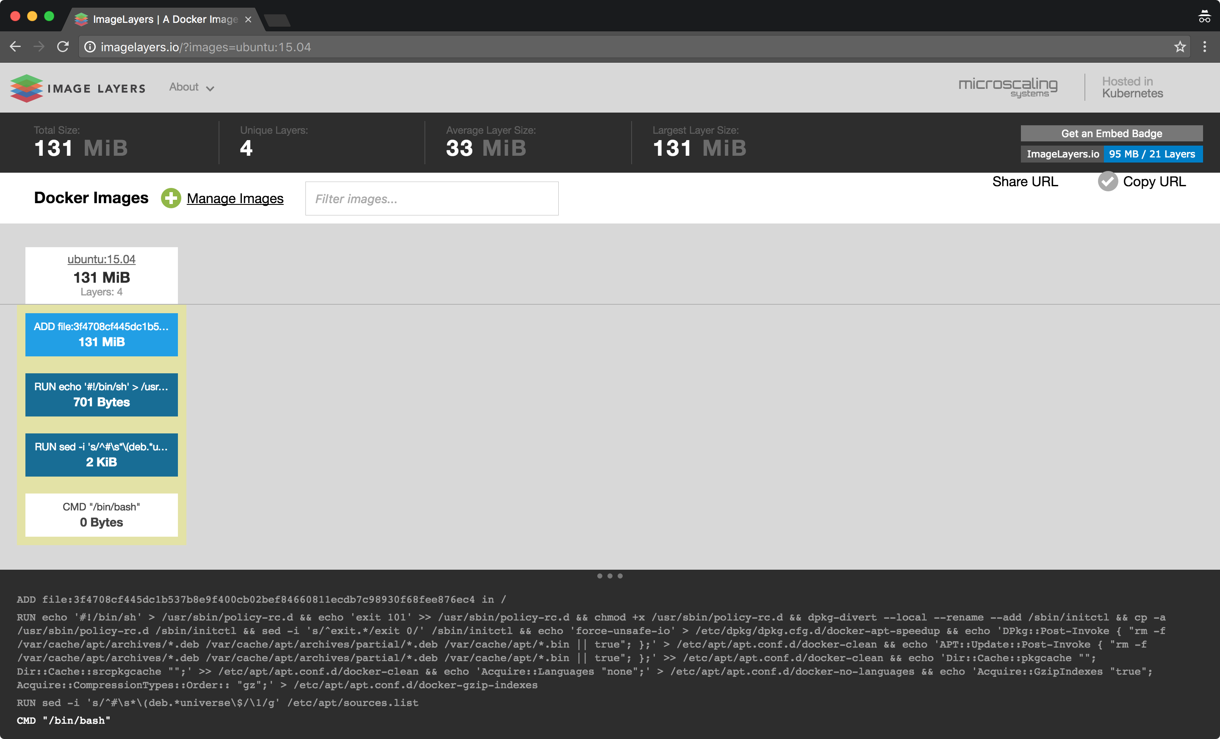
Image Tools
Image layer explorers
imagelayers.io

